Slide 1
Notes:
Fredrik

Slide 2
Project plan and requirements
DVA313 – Group 1
Notes:
Fredrik

Slide 3

The Client
Volvo Construction Equipment in Eskilstuna
Adnan Causevic, Volvo Lab MDH
Notes:
Fredrik

Slide 4
Problem to Solve
Implement an Android application for Co Pilot that is an Android based tablet which has the ability to receive information from the actual machine (speed, direction, ...).
Application should measure some parameters from their different machines and then calculate an eco-driving score. This score will be displayed in a high score list on a web portal that we have to develop.
Concentrate on Eco driving through game solution and improve driving parameters (fuel consumption etc.)
Notes:
Fredrik

Slide 5
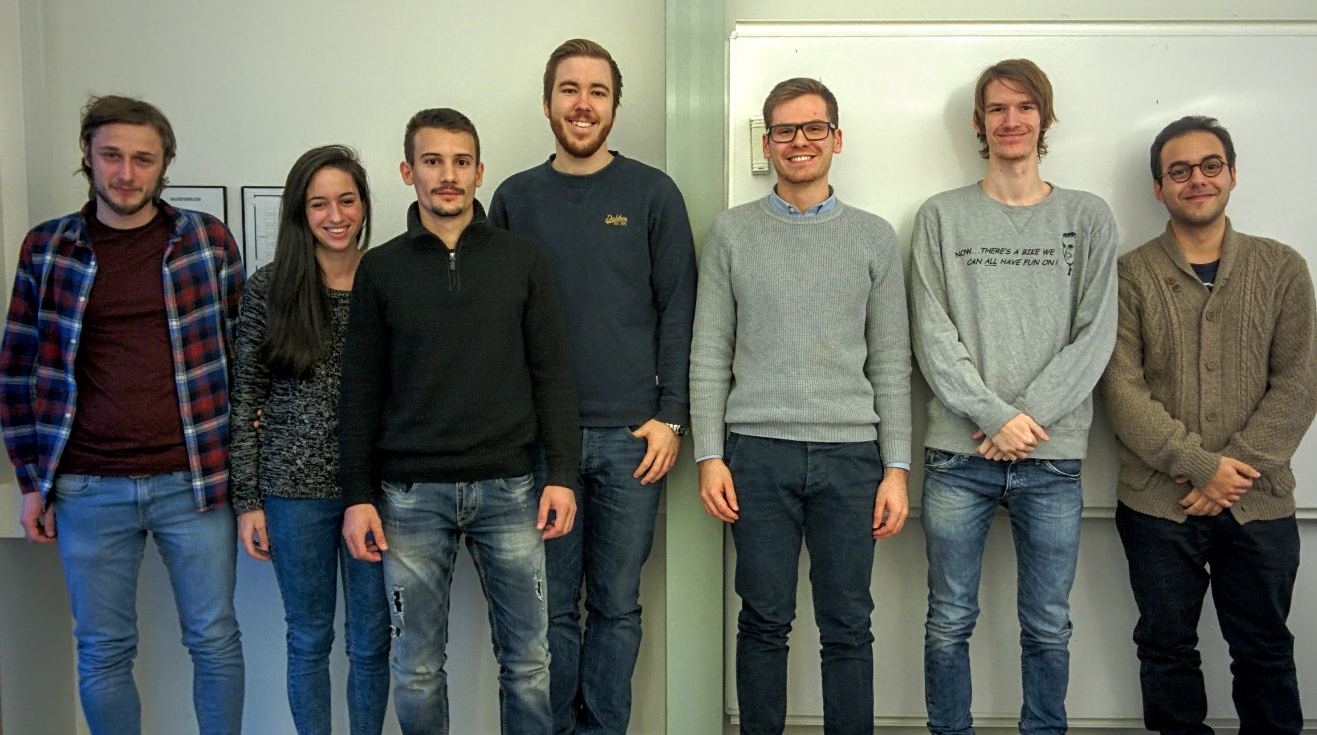
Our Group
Notes:
Vladimir

Slide 6
Roles and responsibilities
Leslie Dahlberg - Tools/environments management
Eric Engtorp
Fredrik Frenning - Room booker
Pooria Ghavamian - Contact
Léa Brunschwig - Documentation
Vladimir Djukanovic
Hamza Sabljakovic - Project manager
Notes:
Vladimir

Slide 7






Communication & Synchronization
Notes:
Vladimir

Slide 8
Meetings with the Client
Initial Meeting, Friday Week 1
We met with Adnan, and two people from Volvo
The presented their vision for the project and gave us concrete requirement
We asked questions and suggested some improvements and discussed how the product would work further
We visited the Volvo Lab and tried driving the simulators
Technical Meeting, Friday Week 2
We met Adnan at Volvo Lab and tested the CoPilot Tablet
Adnan walked us through how to develop and deploy apps for the CoPilot and helped us set up an initial Android Project
Volvo supplied with key-files and tokens so we could start developing
Notes:
Pooria

Slide 9
Initial backlog
Initial backlog presents ideas along with their corresponding user stories, effort estimations in person days and priorities. Focus is on key features that are not so obvious.
Notes:
Pooria

Slide 10
Backlog: Android App
ID | DESC | EFFORT | PRIO
AA_1 | Algorithm | 10 h | High
AA_2 | UI Skeleton | 20 h | High
AA_3 | Game Screen | 20 h | High
AA_4 | High-score Screen | 10 h | Medium
AA_5 | DB SQLite | 10 h | Medium
AA_6 | Graphs | 10 h | Medium
AA_7 | Upload Stats | 5 h | High
AA_8 | Refactoring | 10 h | Low
AA_9 | Testing | 10 h | Medium
AA_10 | Testing on Simulator | 20 h | High
Notes:
Pooria

Slide 11
Backlog: Web Portal
ID | DESC | EFFORT | PRIO
WP_1 | Sketch UI | 25 h | High
WP_2 | DB Design | 10 h | High
WP_3 | DB API | 10 h | High
WP_4 | UI Skeleton | 20 h | High
WP_5 | UI Graphs | 10 h | Medium
WP_6 | UI Back-end | 20 h | High
WP_7 | Refactoring | 5 h | Low
WP_8 | Testing | 10 h | Medium
Notes:
Leslie

Slide 12
Non-Function Requirements
Usable while operating heavy machinery
Safe to use in heavy machinery
Notes:
Leslie

Slide 13
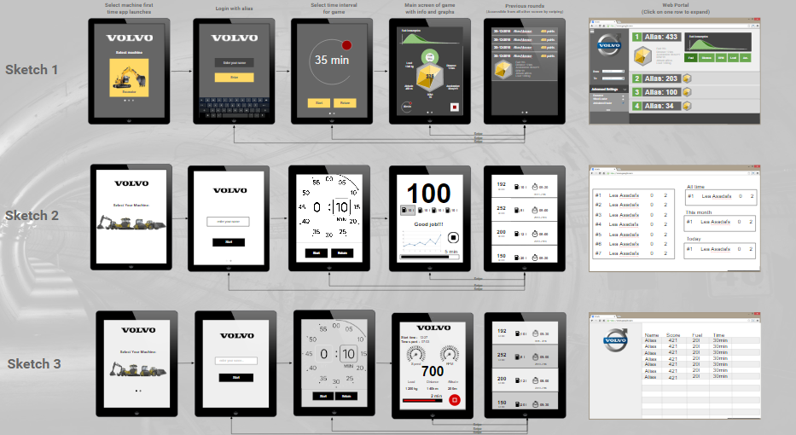
Notes:
Leslie

Slide 14
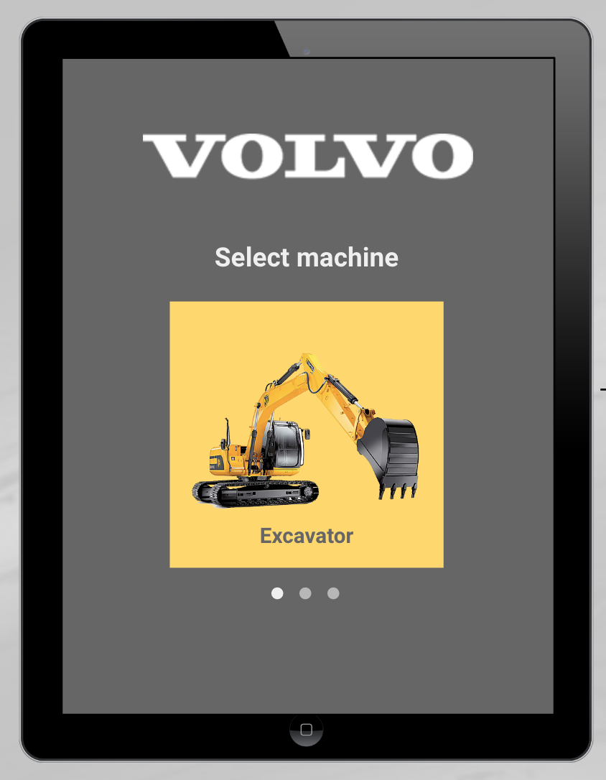
Notes:
Hamza

Slide 15
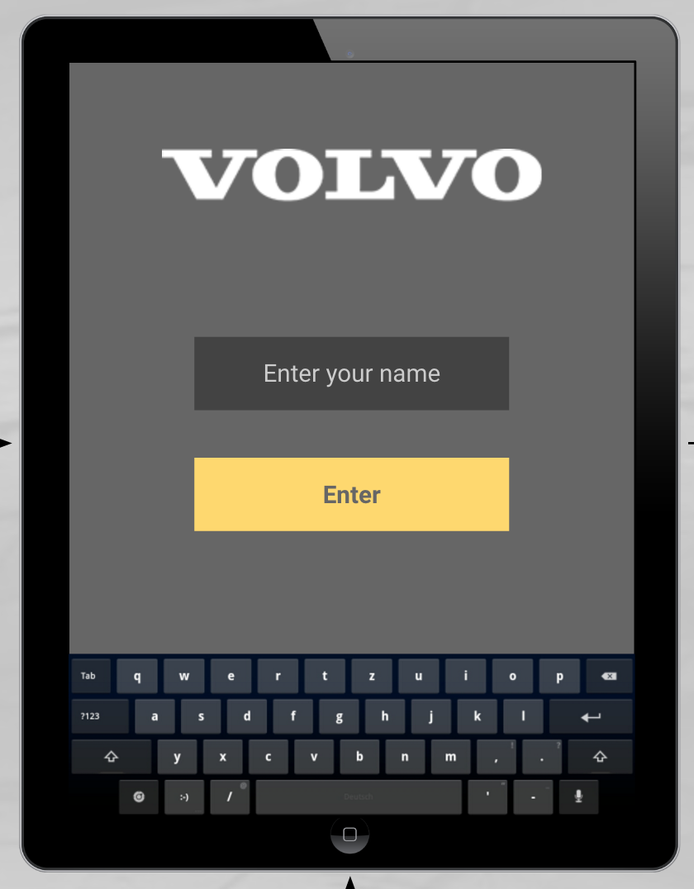
Notes:
Hamza

Slide 16
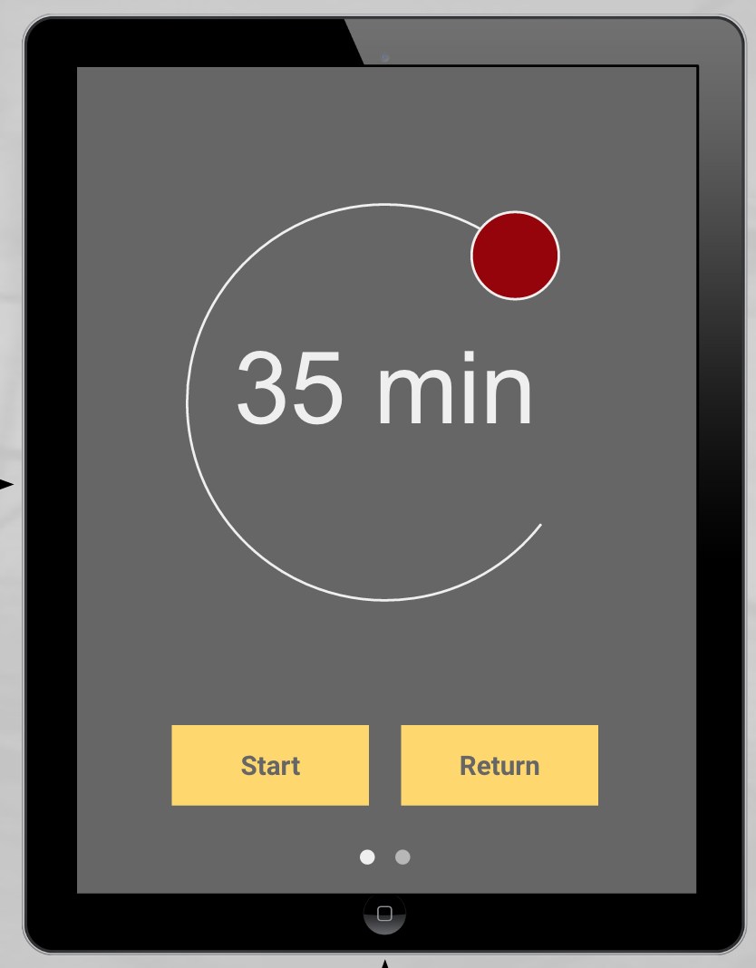
Notes:
Hamza

Slide 17
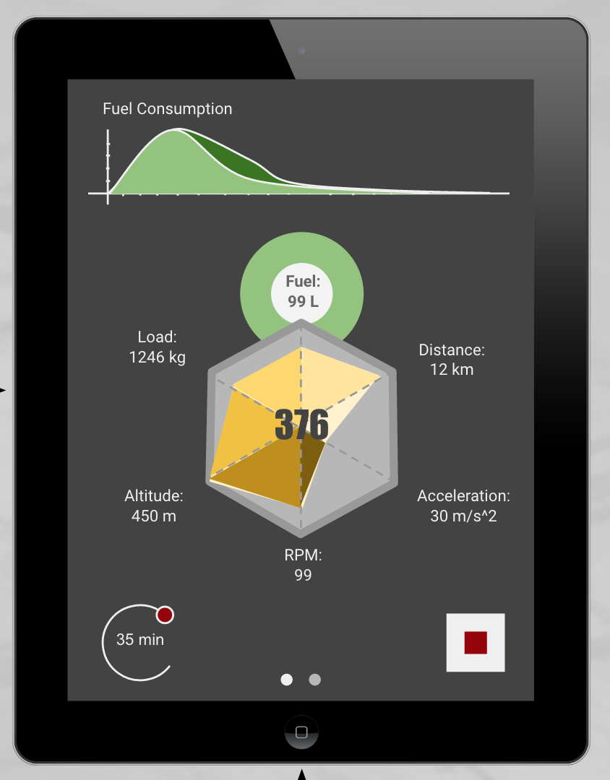
Notes:
Eric

Slide 18
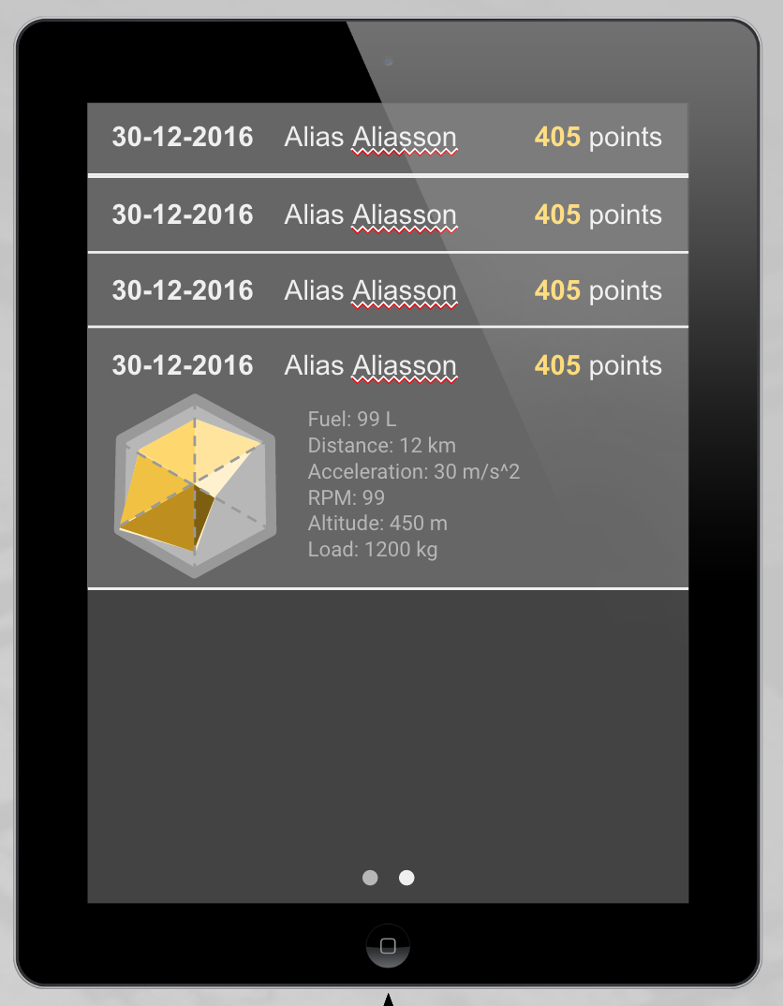
Notes:
Eric

Slide 19
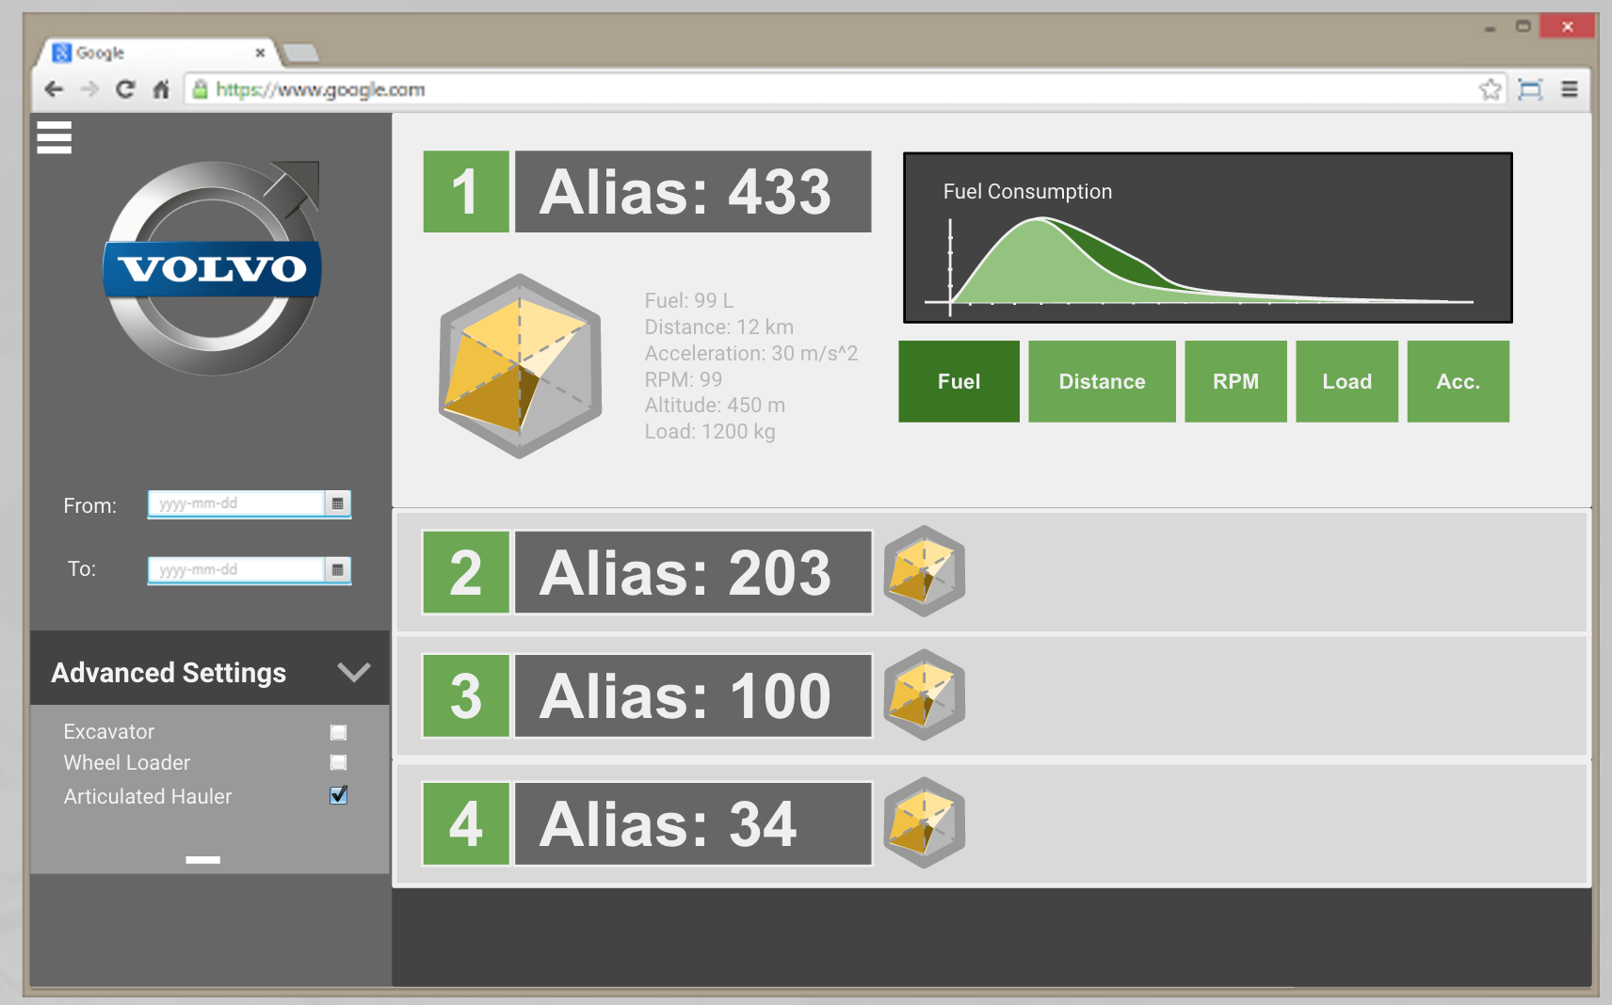
Notes:
Eric

